Slide 1



Digital Portfolio
Student Name:
NM No:
Department:
College/University:
Monisha.M
A8B2B35A0E2783583594F1670EBC4EAC
II.BSC(IT)
Shiri Kumaran College of arts and science
Karamadai/Barathiyar University

Slide 2
AGENDA:
1.Problem statement
2.Project Overview
3.End Users
4.Tools and Technology
5.Portfolio design and Layout
6.Features and Functionality
7.Result and Screenshots
8.Conclusion
9.GitHub Link

Slide 3
PROBLEM STATEMENT:
A problem statement is a concise description of a current issue, the desired future state, and the gap between the two, used to clarify what needs to be addressed in a project, proposal, or research. It provides context, identifies the specific problem and its impact, and explains why a solution or further study is necessary.

Slide 4
1.PROJECT OVERVIEW
A project overview is a high-level summary document that provides a concise, one-page snapshot of a project's purpose, goals, scope, and expected outcomes. It serves as a communication tool to get all stakeholders aligned, a reference point for team members, and a document to secure buy-in from senior management by focusing on the project's value, challenges, and objectives.

Slide 5
2.PORTFOLIO CONTAINS:
*. ABOUT ME
*. SKILLS
!.Hard Skills
!.Soft Skills
*. Hobbies
*. Languages
*. Certificate
*.Contact

Slide 6
3.MAIN IDEA
Creating a project involves defining clear objectives and scope, identifying stakeholders, breaking the project into tasks and milestones, allocating resources and budget, establishing a realistic timeline, identifying and planning for potential risks, and setting up communication channels for progress tracking and stakeholder updates. A project plan acts as a blueprint, guiding the project from initiation through execution to completion and evaluation.

Slide 7
WHO ARE THE END USERS?
To effectively use student projects on a resume, create a dedícated Projects section or integrate them into the Education section for academic projects. Use bullet points to describe each project with a strong action verb, include metrics and technologies, and highlight skills relevant to the job you're applying for. Ensure you use clear language, avoid jargon, and make your projects easily understandable, possibly even linking to them online if possible.

Slide 8
2.JOB SEEKERS PORTFOLIO
Job seekers should share a tailored resume, personalized messages, and their LinkedIn profile with recruiters, clearly stating the type of role they are targeting and why they are are a good fit. Platforms like like Lin LinkedIn allow job seekers to indicate their openness to new roles, directly signaling availability to recruiters. When contacting a recruiter, be professional, brief, highlight key qualifications, and express enthusiasm for the opportunity.
8

Slide 9
3.FREELANCERS
To showcase skills to clients, freelancers should build a portfolio of their work on platforms like Notion, Behance, or Dribbble, and also market themselves on freelance marketplaces such as Upwork and Fiverr, by actively networking on platforms like LinkedIn and Facebook groups, and by leveraging client referrals from their existing network.
9

Slide 10
TOOLS AND TECHNOLOGY
1.HTML:
HTML stands for HyperText Markup Language. It is the standard language used to create and design web pages. HTML structures the content of a webpage using elements like headings, paragraphs, images, links, and tables. It is the backbone of all websites and works together with CSS and JavaScript to build complete web applications.
10

Slide 11
2.CSS:
CSS, or Cascading Style Sheets, is a stylesheet language used to define the visual presentation and layout of web pages. While HTML provides the structural foundation of a webpage, CSS is responsible for its aesthetic qualities and how it appears to users.
11

Slide 12
3.JAVA SCRIPT
JavaScript is a programming language used to make web pages interactive and dynamic. While HTML provides structure and CSS handles design, JavaScript adds ids functionality -such as form validation, animations, image sliders, pop-up messages, and interactive buttons. It is widely used in web development to create responsive and user-friendly websites and applications.
12

Slide 13
PORTFOLIO DESIGN AND LAYOUT
sections included:
*.Home;
My self
Hobby
certificate
Contact:
*.Email
*. Address
*. Contact Number
Skills:
*.Hard Skills
*.Soft Skills

Slide 14
Futures and Functionality
*Futures and Functionality* refers to the potential future developments and features that a product, system, or technology might incorporate to enhance its capabilities, performance, or user experience. This concept is often explored in technology, product design, and strategic planning.

Slide 15
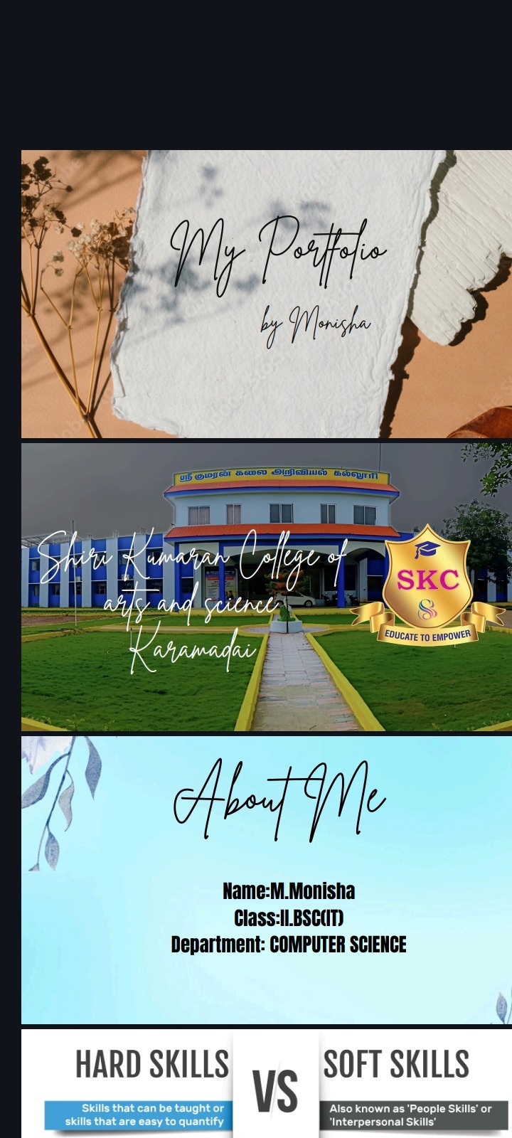
RESULT AND SCREENSHOTS

Slide 16
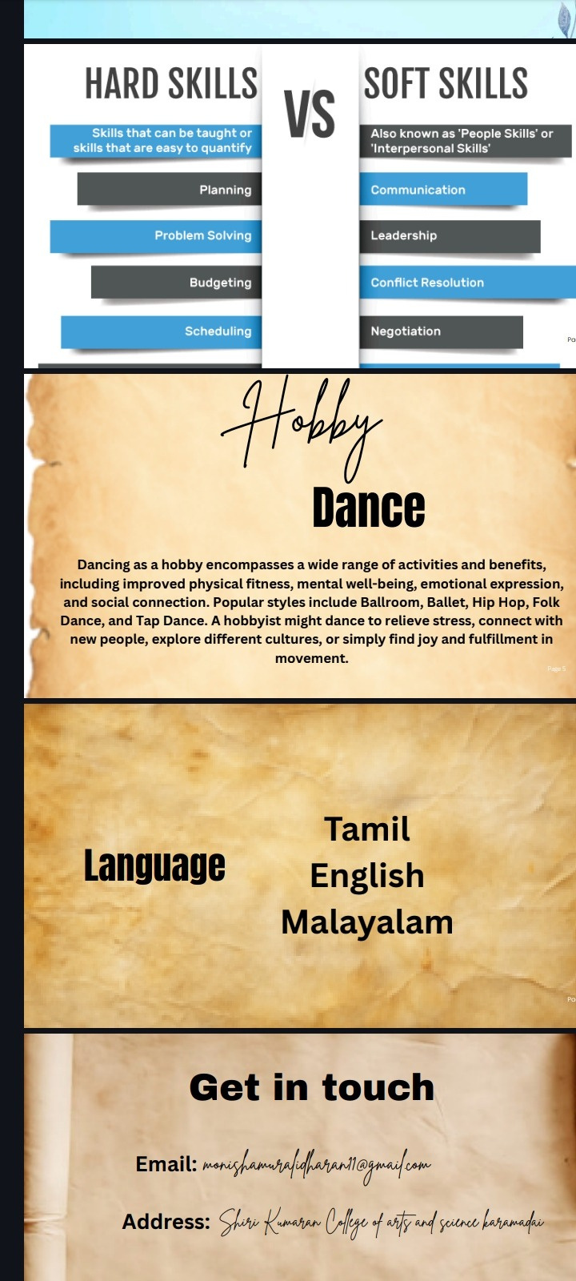
16

Slide 17
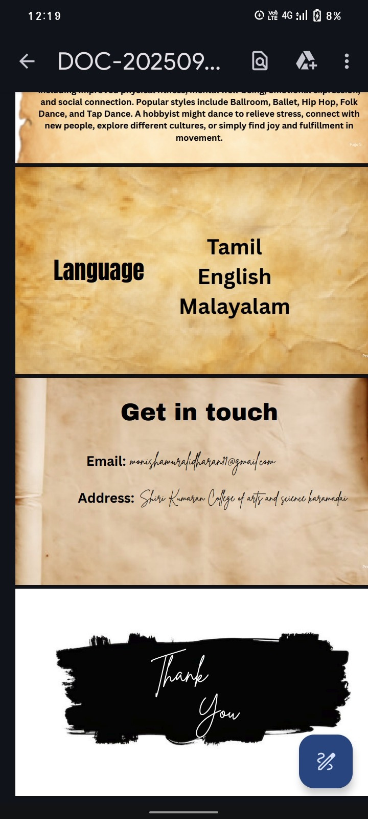
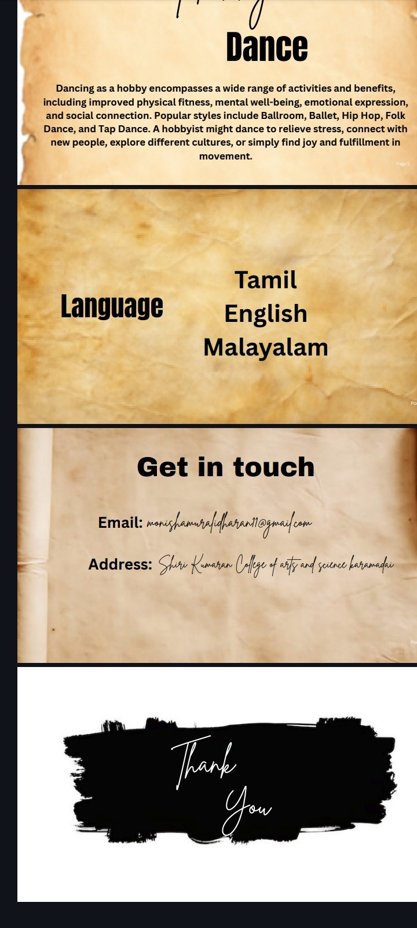
17

Slide 18
CONCLUSION
1. Clear objectives and goals
2. Practical application of knowledge
3. Innovation and creative problem-solving
4. Modern tools and technology
5. Effective teamwork and communication
6. Measurable achievements and impact
These elements drive project success, innovation, and growth.
18

